Slide 1
Triggers

Slide 2
Triggers
What is a trigger?
Trigger is like a procedure that is automatically invoked by the DBMS in response to specified changes to data base
Trigger is like a ‘Daemon that monitors a data base, and is executed when the data base is modified in a way that matches the event specification
A data base that has a set of associated triggers is called an active data base

Slide 3
Trigger Parts
Event
Restriction
Action
A change to data base that activates the trigger
A trigger restriction specifies a Boolean (logical) expression that must be TRUE for the trigger to fire
A procedure that is executed when the trigger is activated.
Similar to stored procedures, a trigger action can contain PL/SQL statements

Slide 4
Types of Triggers
Level
Event
Timings

Slide 5
Level Triggers
Row Triggers
A row trigger is fired each time the table is affected by the triggering statement
If a triggering statement affects no rows, a row trigger is not executed at all
Statement Triggers
A statement trigger is fired once on behalf of the triggering statement, regardless of the number of rows in the table that the triggering statement affects (even if no rows are affected)

Slide 6
Event Triggers
DDL Event Trigger
It fires with the execution of every DDL statement(CREATE, ALTER, DROP, TRUNCATE)
DML Event Trigger
It fires with the execution of every DML statement(INSERT, UPDATE, DELETE)
Database Event Trigger
It fires with the execution of every database operation which can be LOGON, LOGOFF, SHUTDOWN, SERVERERROR etc

Slide 7
Timings Triggers
Before Trigger
It fires before executing DML statement
After Trigger
It fires after executing DML statement.

Slide 8
Syntax For Creating Trigger
CREATE TRIGGER trigger_name trigger_time trigger_event
ON table_name
FOR EACH ROW
BEGIN
--variable declarations
--trigger code
END;

Slide 9
Trigger: Parameters
trigger_name: It is the name of the trigger that we want to create. It must be written after the CREATE TRIGGER statement. It is to make sure that the trigger name should be unique within the schema.
trigger_time: It is the trigger action time, which should be either BEFORE or AFTER. It is the required parameter while defining a trigger. It indicates that the trigger will be invoked before or after each row modification occurs on the table.
trigger_event: It is the type of operation name that activates the trigger.
It can be either INSERT, UPDATE, or DELETE operation.
The trigger can invoke only one event at one time.
If we want to define a trigger which is invoked by multiple events, it is required to define multiple triggers, and one for each event.
table_name: It is the name of the table to which the trigger is associated. It must be written after the ON keyword.
BEGIN END Block: contains a set of queries to define the logic for the trigger.

Slide 10
Example :Update
create trigger tr_b_u
before update on stud_info
for each row
begin
declare action char(10);
set action=‘Update’;
insert into log(ch_date,action) values (now(), action);
end;
create table log(
id int auto_increment primary key,
ch_date datetime,
action char(10)
);

Slide 11
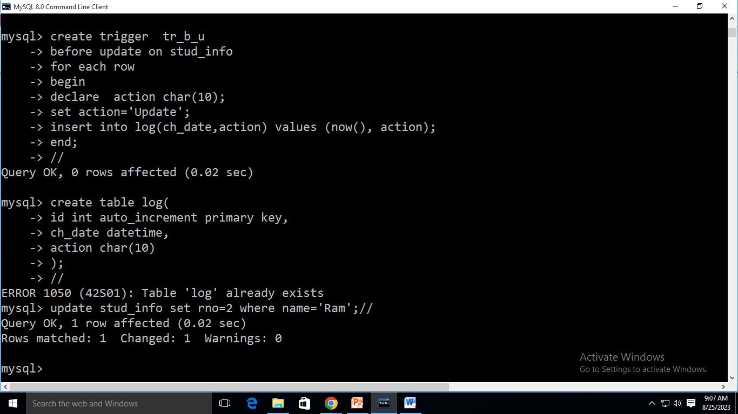
Output

Slide 12
Example :Insert
create trigger tr_i
before insert on stud_info
for each row
begin
declare action char(10);
set action=‘Insert’;
insert into log(ch_date,action) values (now(), action);
end;
create table log(
id int auto_increment primary key,
ch_date datetime,
action char(10)
);

Slide 13
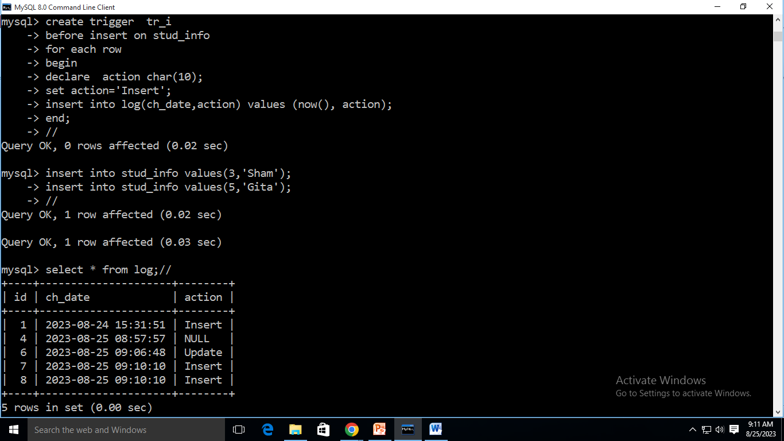

Slide 14
Example :Delete
create trigger tr_d
before delete on stud_info
for each row
begin
declare action char(10);
set action=‘Delete;
insert into log(ch_date,action) values (now(), action);
end;
create table log(
id int auto_increment primary key,
ch_date datetime,
action char(10)
);

Slide 15
NEW and OLD Modifiers
In a row level trigger, the trigger fires for each related row.
Sometimes it is required to know the value before and after the DML statement
There two clauses in the RECORD-level trigger to hold these values
We can use these clauses to refer to the old and new values inside the trigger body
NEW.column_name – It holds a new value for the columns of the base table/view during the trigger execution
OLD.column_name – It holds old value of the columns of the base table/view during the trigger execution

Slide 16
NEW and OLD Modifiers
 | INSERT | UPDATE | DELETE
NEW | VALID | VALID | INVALID. There is no new value in delete case.
OLD | INVALID. There is no old value in insert case | VALID | VALID

Slide 17
Example :Insert
create trigger tr_i
before insert on stud_info
for each row
begin
set new.Name=upper(new.Name);
end;
insert into stud_info values (233, ‘rrrrr’, ‘IT’,9);

Slide 18
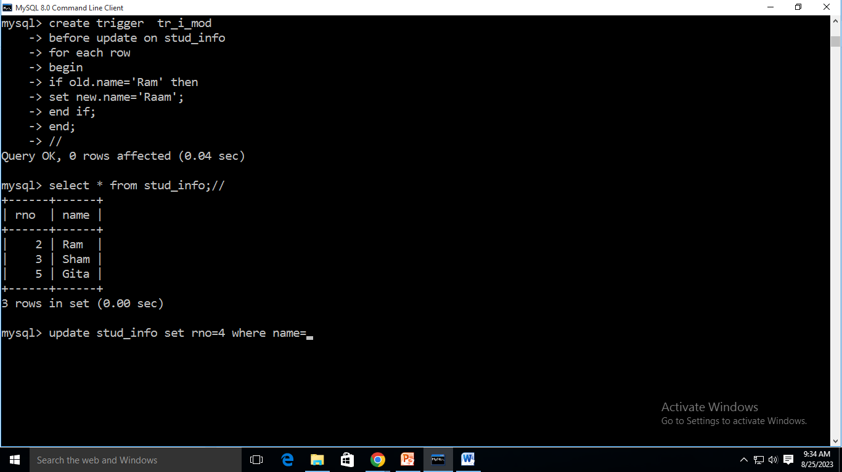

Slide 19
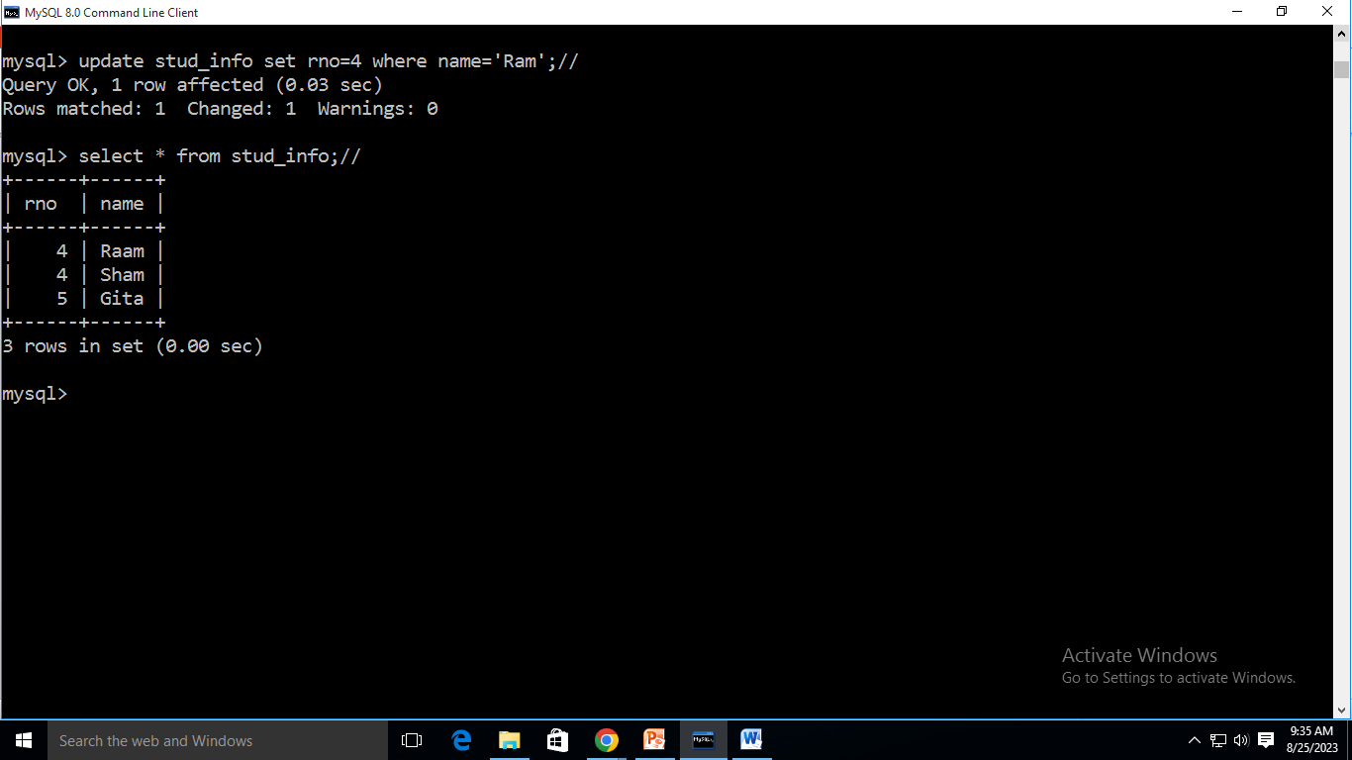

Slide 20
Example
Create table for following schema and insert suitable data into it:
1. Library(BookNo, name, author, publication, year)
2. Library_Audit()
Write a PL/SQL block of code to perform below operations:-
Create a row level trigger which will not allow new entry into Library table if year of publication is before 2005.
Update Library table and change publication to “Pearson Education” where author is “Korth” and create a statement level trigger to count total number of rows affected from this update.
Create a before trigger to keep track of update operation on Library table and add the old value of updated records in Library_Audit table.
Create an after trigger to keep track of delete operation on Library table and add the old value of deleted records in Library_Audit table.

